Slide 1

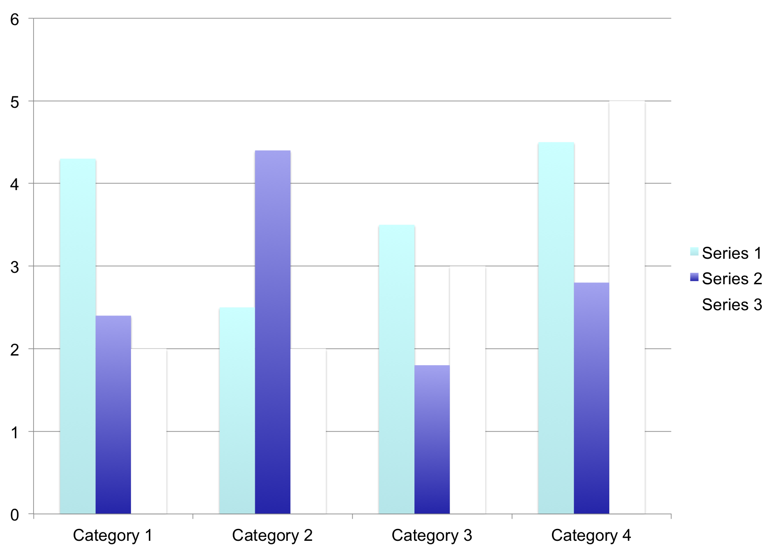
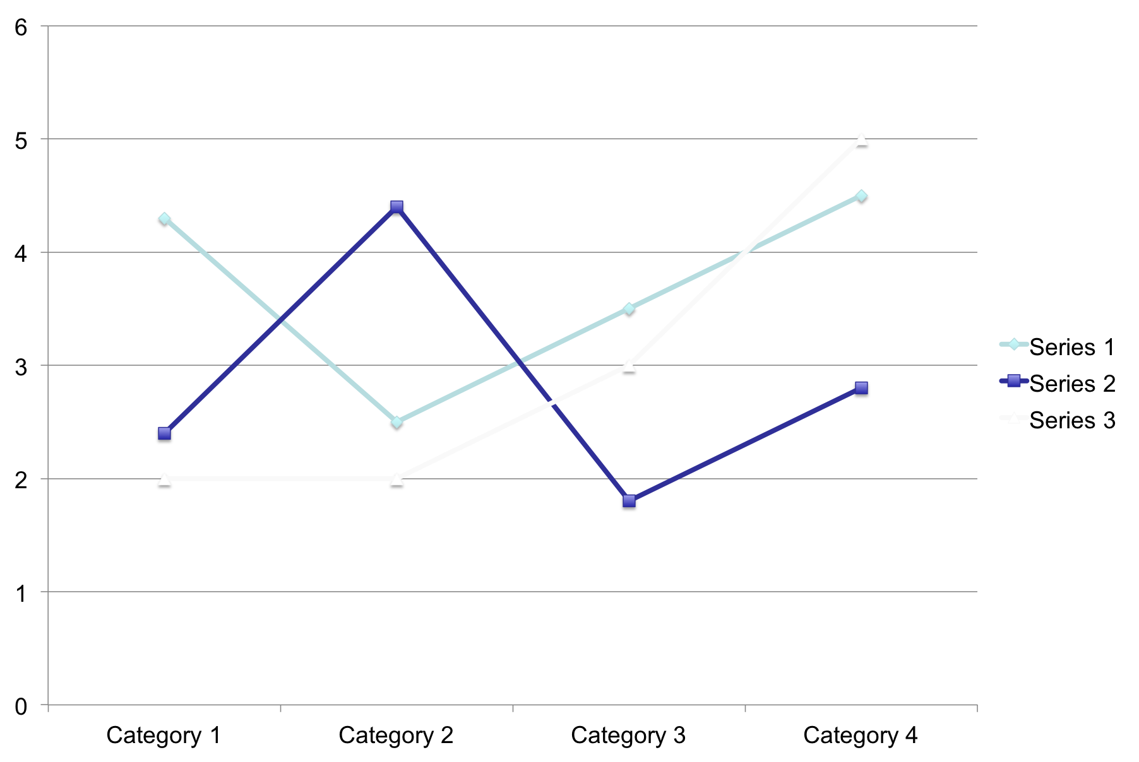
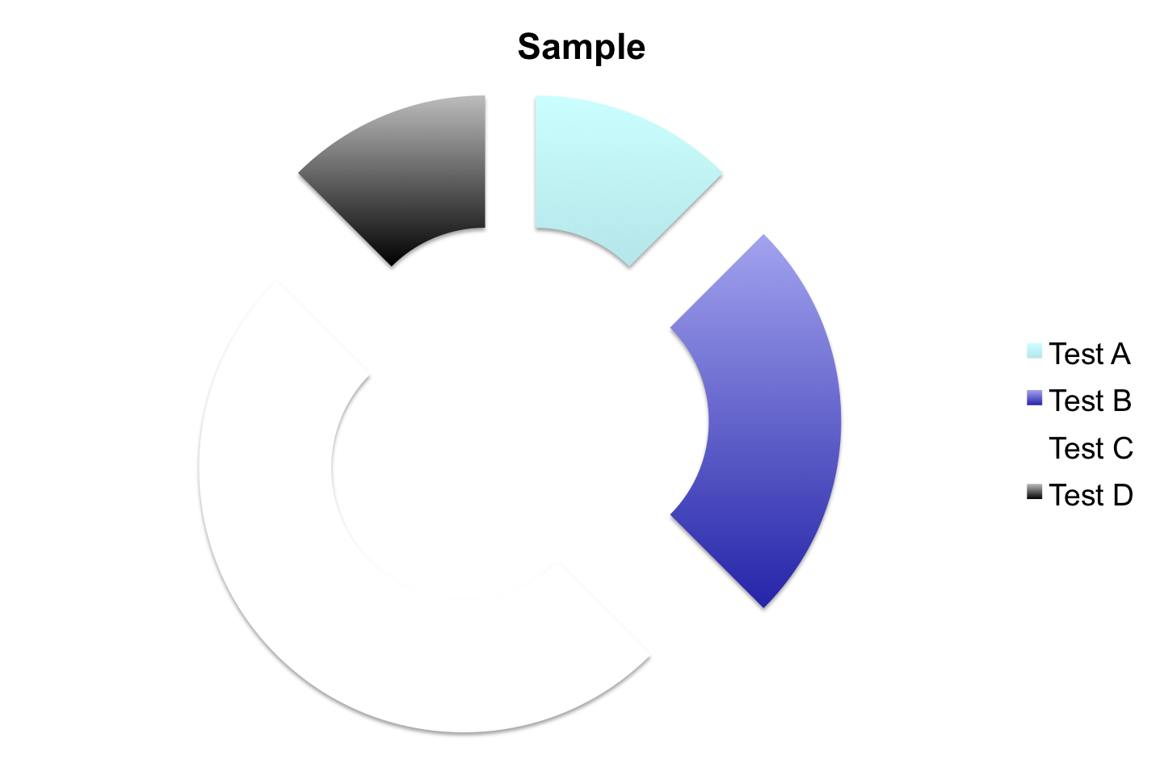
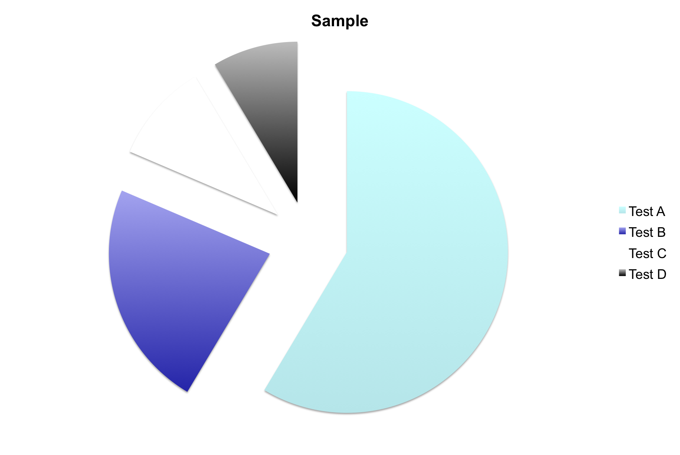
Poster Title Goes Here Researcher/Presenter Names Institution/Organization/Company
2nd LOGO
INTRODUCTION
METHODS
RESULTS
The introduction is the first narrative block that tells a passer‑by why your work matters and sets the stage for the rest of the poster. Because readers skim quickly, keep it concise (usually 3–5 short paragraphs or a handful of bullet points) while still covering the essential elements, such as broad context / background, problem statement, relevance and impact, optional hypothesis, & brief scope / limitations.
The Methods block tells the reader how you obtained your results. Because conference attendees skim quickly, the description must be compact, visual, and self‑contained. Core elements to include in your methods section are study design / overview, materials / samples, procedures / protocols, software / instruments, parameters & settings, statistical / analytical methods, quality control / replicates & any ethical or safety considerations.
The Results block is where you showcase the evidence that answers the question posed in your Introduction. Because viewers spend only a few seconds scanning each poster, the data must be presented visually, concise, and self‑explanatory.
Include key findings, figures / graphs, tables, statistical summary, error bars / uncertainty, representative images, comparative controls, etc…
The following figures illustrate how this structure will give viewers a rapid, compelling reason to explore your methods, results, and conclusions
The following figures demonstrate the impact of…
Fig. 5: Each visual should answer a specific question
The Results section should become a visual story that lets conference attendees grasp the essence of your findings within seconds, while still providing enough detail for interested peers to dive deeper.
Fig. 3: A visual element that summarizes the process
CONCLUSIONS
Visual enhancements can be a flow diagram / schematic showing the logical progression from input, processing, output, tables for parameters which can work well for well for instrument settings, concentrations, or software versions, and icons / mini‑graphics to guide the eye without clutter. Remember to assign a consistent color (e.g., teal) to graphics; ensure sufficient contrast for print.
Fig. 1: Keeping sentences to ≤ 20 words Improves readability at a glance
Fig. 2: Adding a small graphic or icon reinforces the topic
The Conclusions block is the last impression you leave on a viewer. It must distill everything you’ve shown into a few clear take‑aways and point the audience toward the next steps or broader implications. Because readers often skim straight to the end, keep this section short, punchy, and visually distinct. the Conclusions section provides a memorable, actionable summary that encourages viewers to remember your key message long after they walk away from the poster.
Mention the field or sub‑discipline so readers instantly know the domain (materials science, bioinformatics, etc.). Pinpoint the knowledge gap, limitation, or unresolved question your study addresses. Phrase it as a clear, testable problem (“Current sensors lack sub‑ppm sensitivity for NO₂ detection in ambient air.”). Briefly explain why solving this problem matters—to the community, industry, policy, or downstream applications. Quantify impact if possible (e.g., “Improving sensor sensitivity could reduce monitoring costs by 30 %.”). Concisely state the primary aim of your work. When appropriate, include a concise hypothesis.
REFERENCES
1. Reference, Name of reference
2. Reference, Name of reference
3. Reference, Name of reference
4. Reference, Name of reference
5. Reference, Name of reference
6. Reference, Name of reference
Fig. 4: writing style effectiveness is demonstrated

